Slide 1
Morphometric Analysis of Neuroimaging Data (Structural MRI)
Neuroimaging Bootcamp | CFMI & IPN | August 17, 2016

Slide 2
Quantification of Anatomic Differences
Voxel-Based Morphometry (VBM)
Examination of the differences and changes in anatomy
Size, Shape, or Density
Based on features that can be seen in MR images
Diffusion Tensor Imaging (DTI)
MRI technique sensitive to diffusion of water molecules
Provides images of fiber tracts
Cortical Thickness (CT)
Like VBM, reflects the size, density, and arrangement of cells
Measures total thickness of cortical layers
Notes:
Goal for each imaging technique will be to provide understanding of general idea, pre-processing, and analysis involved in each measure

Slide 3
Quantification of Anatomic Differences
Voxel-Based Morphometry (VBM)
Examination of the differences and changes in anatomy
Size, Shape, or Density
Based on features that can be seen in MR images
Diffusion Tensor Imaging (DTI)
MRI technique sensitive to diffusion of water molecules
Provides images of fiber tracts
Cortical Thickness (CT)
Like VBM, reflects the size, density, and arrangement of cells
Measures total thickness of cortical layers
Notes:
Goal for each imaging technique will be to provide understanding of general idea, pre-processing, and analysis involved in each measure

Slide 4
Voxel-Based Morphometry (VBM): Automated Morphometric Methods
Identifies regions with differences in gray-matter, white-matter, or CSF concentration
Relies on segmentation algorithms to classify each voxel in an MRI by the type of tissue
Produce map of statistically significant differences among population of subjects
Notes:
Based on comparing regional volumes of tissue among populations of subjects
Produce a map of statistically significant differences among populations of subjects
compare a patient group with a control group
identify correlations with age, test-score etc.

Slide 5
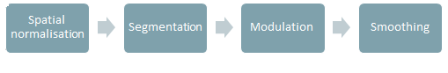
Voxel-Based Morphometry (VBM), cont.
Processing Steps:
Spatially normalize
Segment each brain into gray matter, white matter, and CSF
Statistically compare on a voxel-by-voxel basis gray matter probabilities or concentration between subject groups
Notes:
Voxel-based morphometry of MRI data involves spatially normalizing all the images to the same stereotactic space, extracting the gray matter from the normalized images, smoothing, and finally performing a statistical analysis to localize, and make inferences about, group differences. So you preprocess the data in a way that makes it sensitive to differences in certain tissue volumes. The output from the method is a statistical parametric map showing regions where tissue matter, like gray matter, concentration differs significantly between groups.

Slide 6
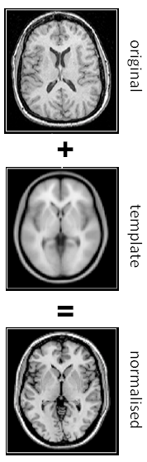
Spatial Normalisation
Put each brain into the same stereotactic space
Correct for global brain shape differences
Notes:
Transform all subject’s data to same stereotactic space
Corrects for global brain shape differences
Use of a template image (that ideally doesn’t bias result)

Slide 7
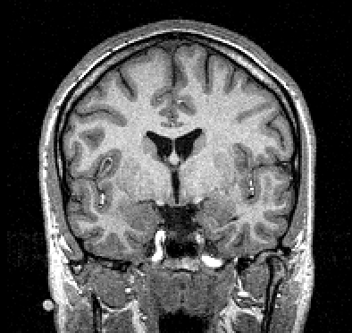
Tissue Segmentation
Notes:
This problem is referred to as tissue segmentation
Goal is to identify the areas in the brain that correspond to the three major classes of tissue: GM, WM, CSF (extra tissue maps can be generated)
Uses two sources of information:
Spatial prior probability maps (e.g. intensity at each voxel = probability of being GM/WM/CSF)
Intensity info in the image itself
SPM assigns a voxel to a tissue class based on its intensity relative to others in the image
Value b/w 0-1, representing probability of it being in that particular tissue class

Slide 8
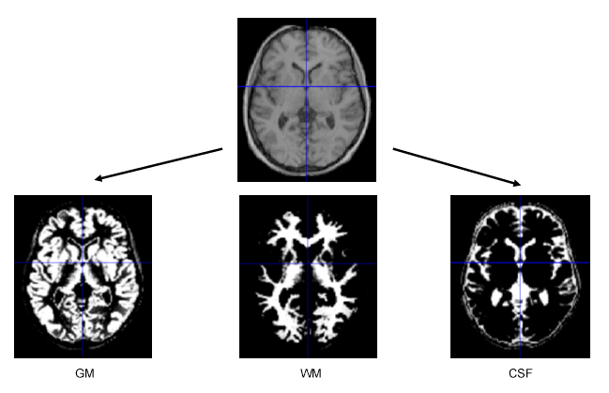
Tissue Segmentation
Computer Expert

Slide 9


Types of VBM Analyses
Group differences assessed by using voxel-by-voxel statistical comparison of the gray-matter, white-matter, and CSF probability maps
Correlations with behavioral measures
a known score or value

Slide 10
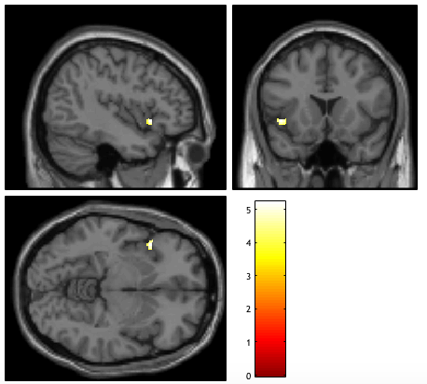
VBM Analyses: Correlation Example
L
L
L
R
R
Correlation between GMV in the Left inferior frontal gyrus (BA47) and Adjusted Family Income

Slide 11
Quantification of Anatomic Differences
Voxel-Based Morphometry (VBM)
Examination of the differences and changes in anatomy
Size, Shape, or Density
Based on features that can be seen in MR images
Diffusion Tensor Imaging (DTI)
MRI technique sensitive to diffusion of water molecules
Provides images of fiber tracts
Cortical Thickness (CT)
Like VBM, reflects the size, density, and arrangement of cells
Measures total thickness of cortical layers

Slide 12
Quantification of Anatomic Differences
Voxel-Based Morphometry (VBM)
Examination of the differences and changes in anatomy
Size, Shape, or Density
Based on features that can be seen in MR images
Diffusion Tensor Imaging (DTI)
MRI technique sensitive to diffusion of water molecules
Provides images of fiber tracts
Cortical Thickness (CT)
Like VBM, reflects the size, density, and arrangement of cells

Slide 13
Diffusion Tensor Imaging (DTI)
MR imaging technique in which contrast is based on differences in the diffusion of water molecules
DTI used to identify and generate maps of white matter fibers

Slide 14
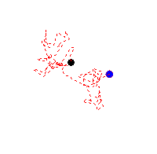
Diffusion Tensor Imaging
Diffusion-tensor MRI relates image intensities to the relative mobility of water molecules in tissue and the direction of the motion
Motion of a water molecules is a random walk (Brownian motion)
Areas with relatively high mean diffusion will appear dark on the Diffusion weighted MRI images

Slide 15
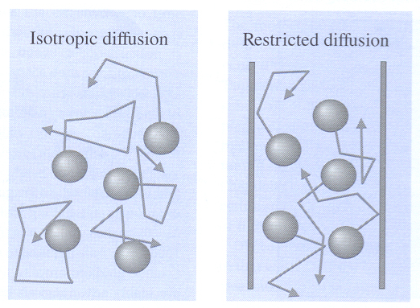
Types of Molecular Motion
Diffusion in an open pool of fluid (Ventricles)
Diffusion in an axon

Slide 16
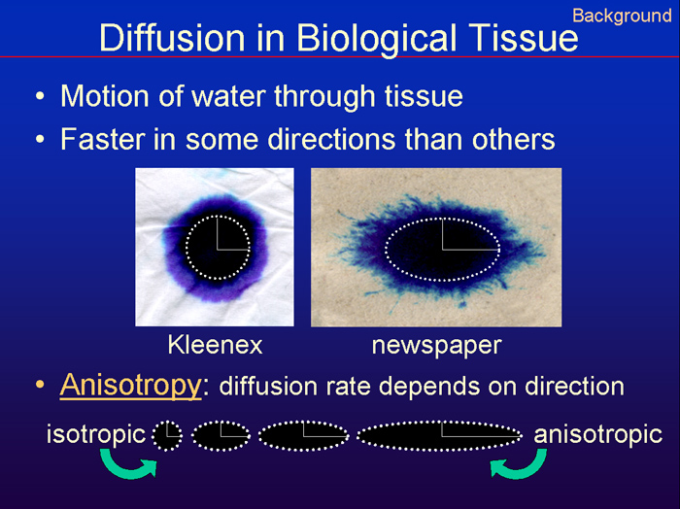
Types of Isotropy
Kleenex
Newspaper
Isotropic
Anisotropic
Isotropic
Anisosotropic
Notes:
Motion of water through tissue
Sometimes faster in some directions than in others
Anisotropy: diffusion rate depends on direction

Slide 17
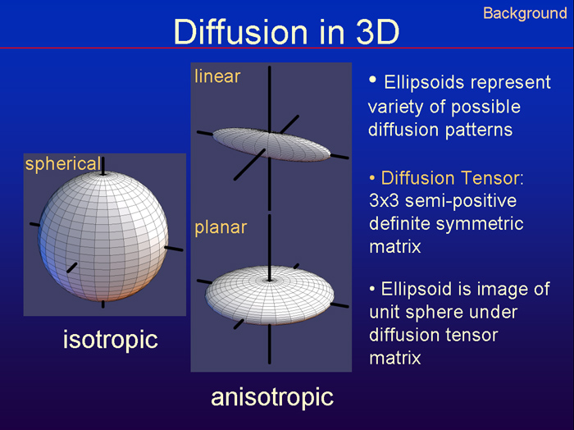
Types of 3D Isotropy
Isotropic
Anisotropic

Slide 18
DTI Calculation
Diffusion properties described with a 3 X 3 symmetric tensor matrix
Eigenvalues of the diffusion tensor are the diffusion coefficients (λ_{x}, λ_{y}, and λ_{z}) in the three principal directions of diffusivity
The eigenvector corresponding to the largest eigenvalue is the main direction of diffusion
Maps are constructed from various anisotropy indices calculated from the eigenvalues

Slide 19
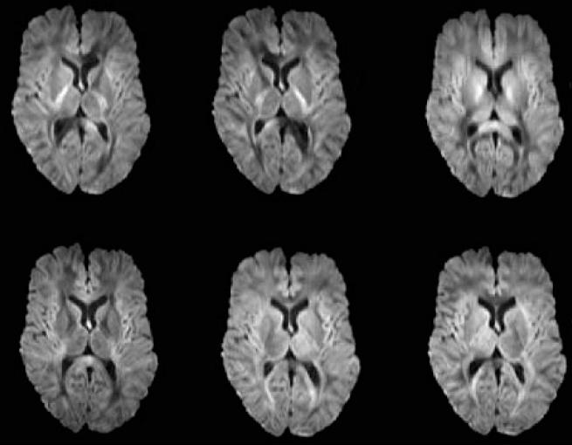
Raw Diffusion Images
Diffusion sensitive gradients applied in six directions all with b=1000
Dark areas represent areas with a higher degree of diffusion

Slide 20
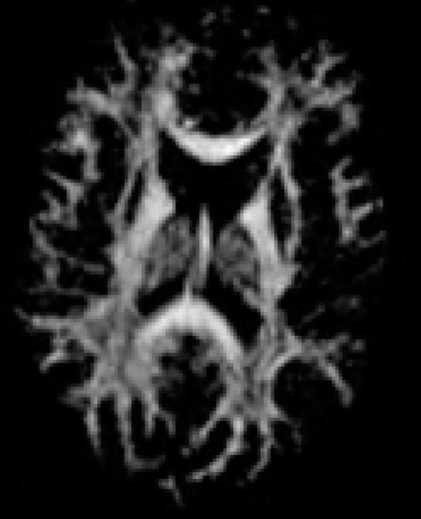
Fractional Anisotropy (FA) Index
Measure of degree of anisotropy regardless of direction
Brighter areas correspond to areas with higher degree of diffusion
FA² = (λ_{x} - λ_{y})² + (λ_{x} - λ_{z})² + (λ_{y} - λ_{z})²
2(λ_{x}² + λ_{y}² + λ_{z}²)

Slide 21
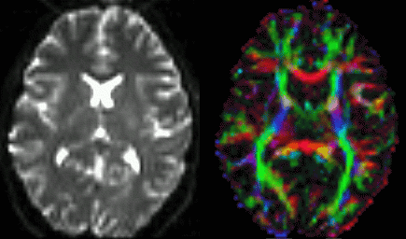
Direction of Diffusion
Red = Left-Right
Green = Anterior-Posterior
Blue = Superior-Inferior

Slide 22
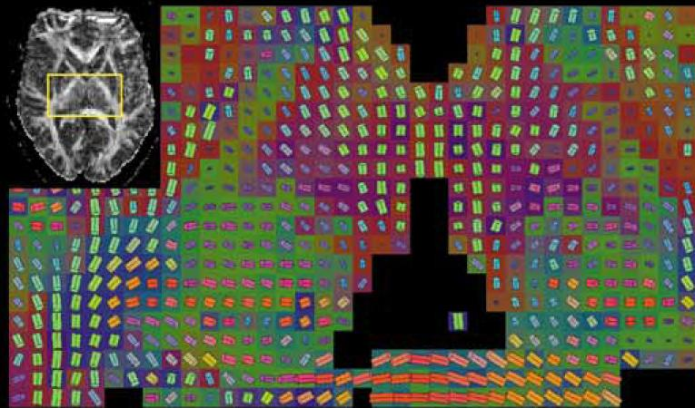
Tractography
Use primary direction calculated from tensor as input
Connect neighboring voxels if the tensor in one points towards the other
Tracts built from a collection of connected voxels

Slide 23
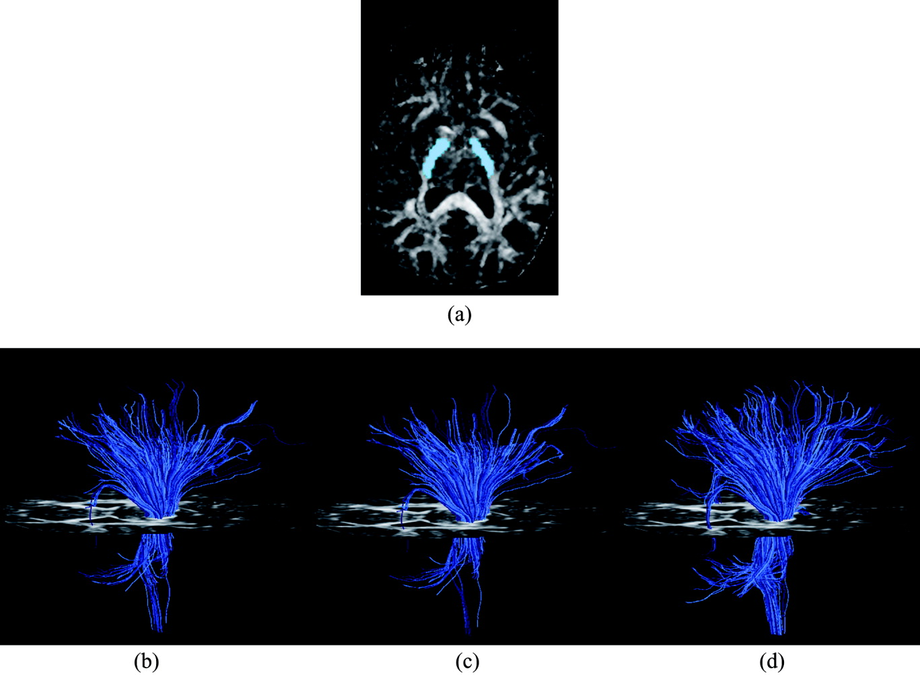
Tracts Originating from Internal Capsule
Lazar et al., 2003

Slide 24
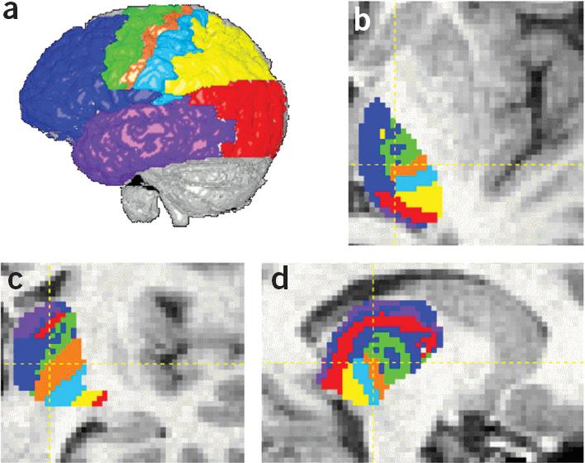
Connectivity-Based Segmentation of Thalamus
Behrens et al., 2003

Slide 25
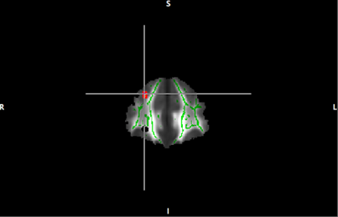
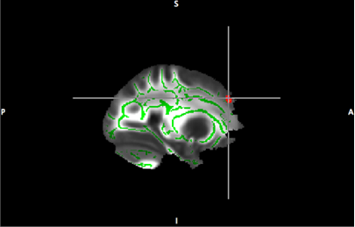
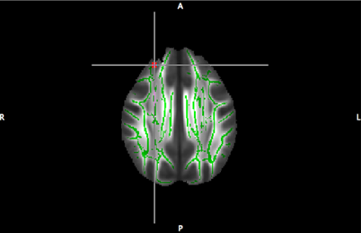
DTI analyses: Group comparison example
How does white matter organization relate to risk for alcohol use in alcohol-naïve adolescents?
Low Risk Adolescents > High Risk Adolescents
corpus callosum projection to R superior frontal lobe
(p < 0.001, not corrected for multiple comparisons)
Notes:
Like VBM, we can think about group comparisons and correlations to behavior
We could correlate FA values with obtained behavioral data (like maybe performance on a task that might imply the frontal lobe)

Slide 26
Quantification of Anatomic Differences
Voxel-Based Morphometry (VBM)
Examination of the differences and changes in anatomy
Size, Shape, or Density
Based on features that can be seen in MR images
Diffusion Tensor Imaging (DTI)
MRI technique sensitive to diffusion of water molecules
Provides images of fiber tracts
Cortical Thickness (CT)
Like VBM, reflects the size, density, and arrangement of cells
Measures total thickness of cortical layers
Notes:
Less detail on CT, but becoming more widely used in imaging research so a primer will be helpful for talks you might encounter

Slide 27
Quantification of Anatomic Differences
Voxel-Based Morphometry (VBM)
Examination of the differences and changes in anatomy
Size, Shape, or Density
Based on features that can be seen in MR images
Diffusion Tensor Imaging (DTI)
MRI technique sensitive to diffusion of water molecules
Provides images of fiber tracts
Cortical Thickness (CT)
Like VBM, reflects the size, density, and arrangement of cells
Measures total thickness of cortical layers
Notes:
Individual differences, but also widely studied age-associated cortical thinning and longitudinal changes

Slide 28
Cortical Thickness (CT)
Of interest in normal development as well as wide variety of neurodegenerative and psychiatric disorders
Thickness can only be properly measured if location and orientation of gray/white and pial surfaces are known
Automated methods for use in MRI may be either surface-based, voxel-based, or a mixture of the two

Slide 29
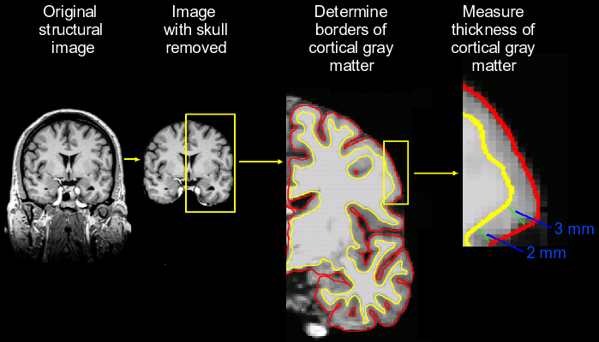
Cortical Thickness (CT)
Notes:
The process of cortical thickness analysis is similar to VBM, albeit the analysis is performed at the nodes of a three-dimensional polygonal mesh rather than a 3D voxel grid—this metric captures the distance between the WM surface and gray CSF intersection. The output is a scalar value in mm.

Slide 30
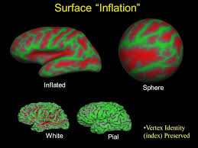
Cortical Thickness (CT):
Dealing with Cortical Geometry
Highly convoluted surface is a problem
Solution: inflate the brain!

Slide 31
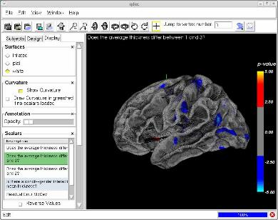
Cortical Thickness (CT)
Freesurfer automatically extracts cortical thickness measures
Other software: BrainVoyager, FSL, packages from NIH
surfer.nmr.mgh.harvard.edu
Notes:
Freesurfer is a freely available software created at Harvard that is the standard program in cortical thickness preprocessing and analyses—its stream is very well-documented and also GUI-friendly. For statistical analyses, I used QDEC, Freesurfer’s internal statistical application that uses a general linear model (GLM) for group analyses. The image is an example of the QDEC GUI.
For each of the primary questions, analyses were restricted to the RIGHT hemisphere.
Participants in study:
Patients were MRI-eligible native English-speakers with LH stroke at least 6 months prior to enrollment; exclusion criteria incl. other stroke history, brain injury, or neurological, psychiatric, or learning disorders
Control participants had the same criteria sans a history of stroke
Groups matched on age, gender, education, hypertension, etc. and were also matched for this project
Note that the number of Patients (n = 23) is NOT reflective of number of Patients in the study as a whole. I used a lower number due to failure of the preprocessing stream for a number of subjects, likely due to characteristics of their lesions that are problematic for Freesurfer’s algorithms.
Also of note, 1 patient (EFT) does NOT have aphasia based on scores of the WAB.

Slide 32
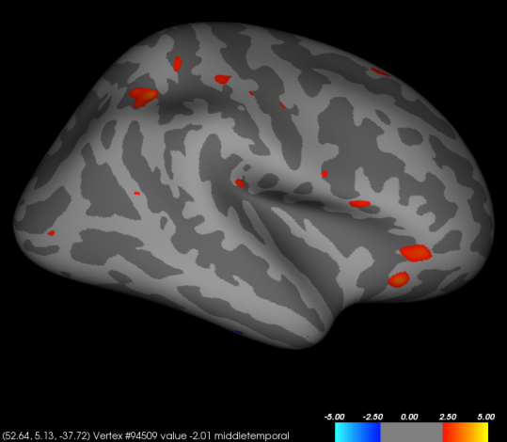
Cortical Thickness (CT) analyses: Group comparison example
Does the average cortical thickness in the right hemisphere differ between Stroke Patients and Controls?
Inferior parietal
Lateral orbitofrontal
Pars opercularis
Pars orbitalis
Precuneus
N = 50
p < 0.01, un-corrected
Notes:
First, we asked whether there is a difference in average cortical thickness in the RH between patient and control groups. We hypothesized that patients would show an increase in cortical thickness relative to controls. I used a simple between-group comparison using a general linear model implemented in QDEC, the program noted on the Methods slide. This analysis accounted for age as a covariate, due to previous research showing that cortical thickness generally decreases with age.
Recall that we hypothesized that cortical thickness in the right RH would increase in homotopic RH regions. However, we actually see—within this group of subjects—that there is still a persistent decline in cortical thickness over age for both Patients and Controls.
Also, I controlled for RH cortex and RH WM volume and found no change in results.

Slide 33
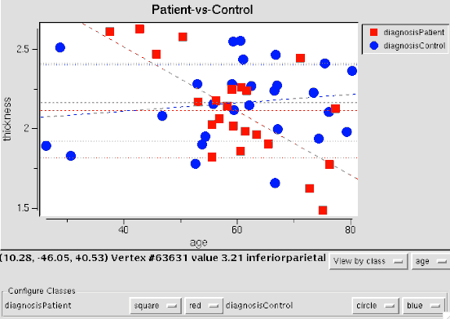
Cortical Thickness (CT) analyses: Group comparison example
Does the average cortical thickness in the right hemisphere differ between Stroke Patients and Controls?
N = 50
p < 0.01, un-corrected
Notes:
First, we asked whether there is a difference in average cortical thickness in the RH between patient and control groups. We hypothesized that patients would show an increase in cortical thickness relative to controls. I used a simple between-group comparison using a general linear model implemented in QDEC, the program noted on the Methods slide. This analysis accounted for age as a covariate, due to previous research showing that cortical thickness generally decreases with age.
Recall that we hypothesized that cortical thickness in the right RH would increase in homotopic RH regions. However, we actually see—within this group of subjects—that there is still a persistent decline in cortical thickness over age for both Patients and Controls.
Also, I controlled for RH cortex and RH WM volume and found no change in results.

Slide 34
DTI Data Processing Plans
QA
Register Runs
use b=0 images
apply rotations from transform to B-matrix
fMRI Processing
foci
DTI Calculation
FA
Color-coded
Talairach
Correlation with Behavioral Measures
Group Statistics
Tractography Calculation
Susumu Mori’s DTI Studio

Slide 35
Cortical Thickness (CT): Data Examples

Slide 36
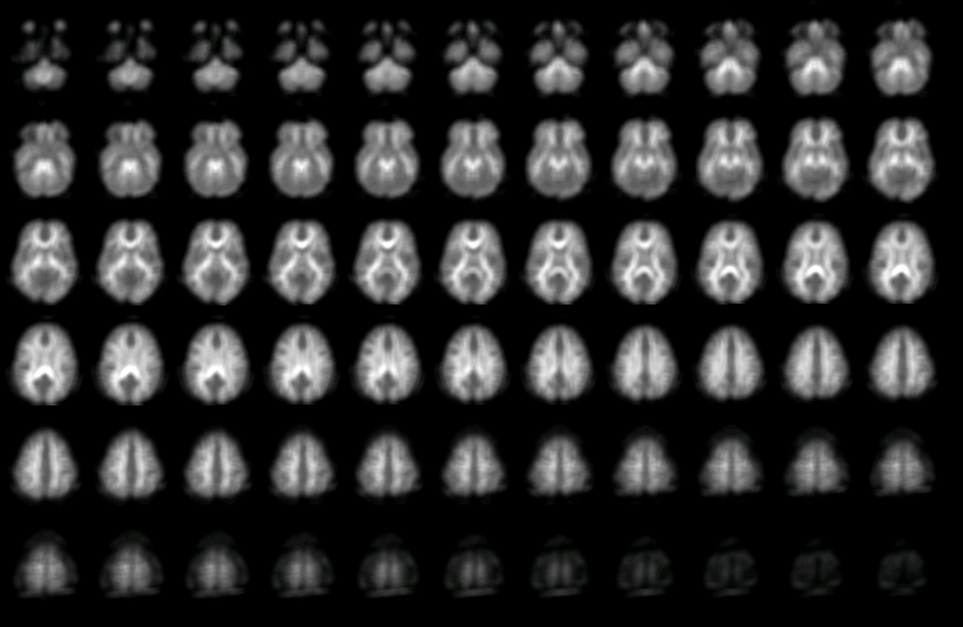
Average FA in ASD

Slide 37
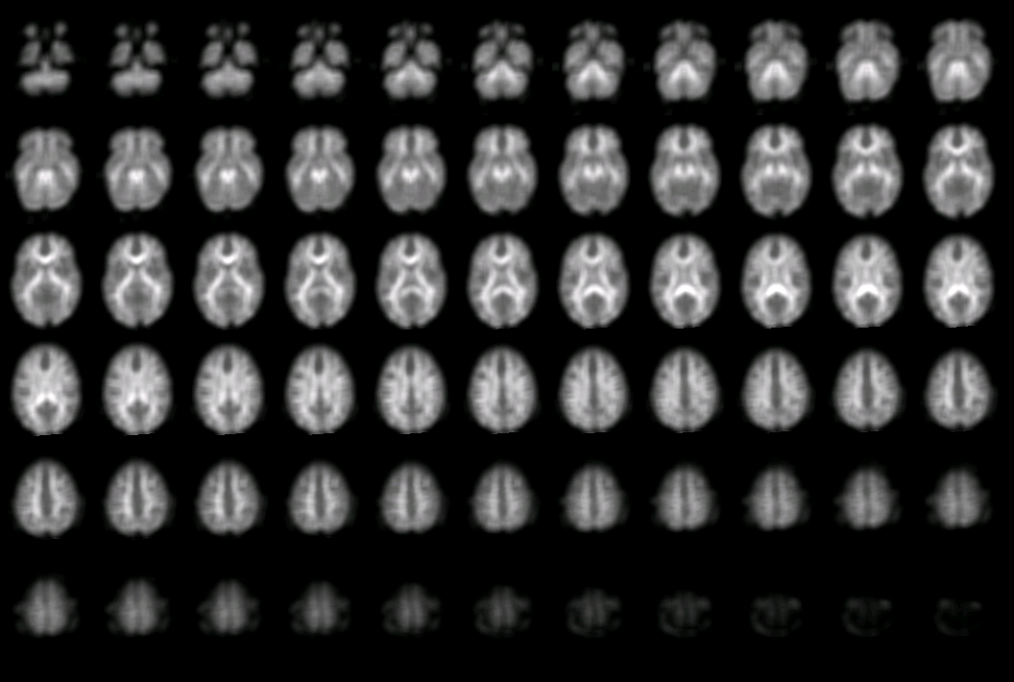
Average FA in Age-Matched Controls

Slide 38
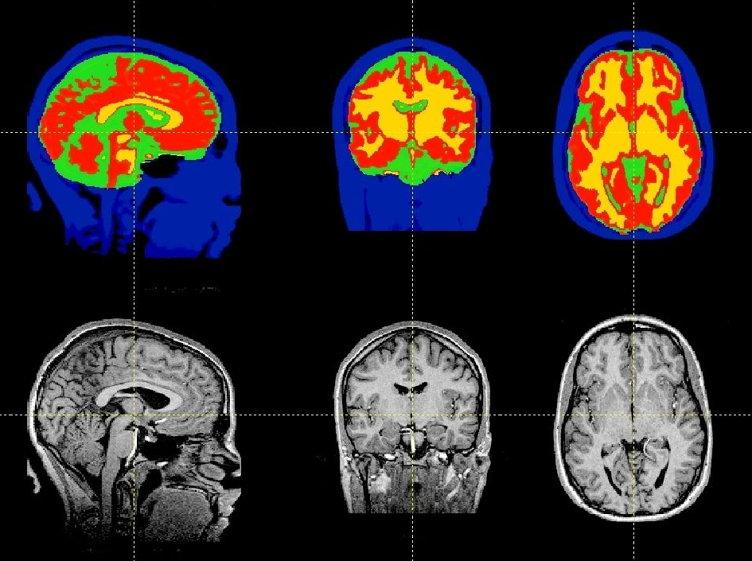
3D Segmentation
Notes:
We now have an automatic tool for tissue classification which can be applied to clinical questions

Slide 39
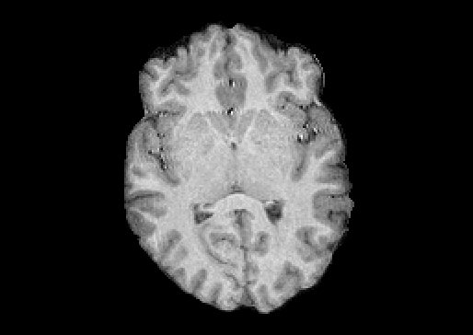
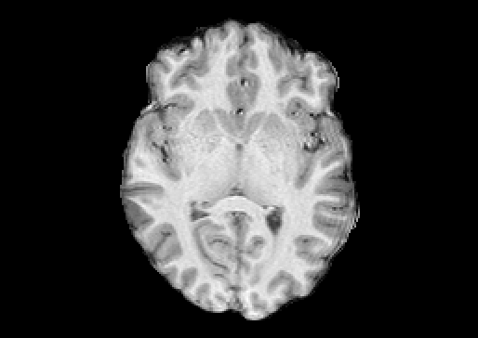
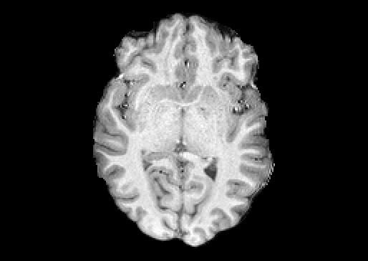
Restored Images
CP Head Coil Phased Array Phased Array
no iPAT GRAPPA iPAT

Slide 40
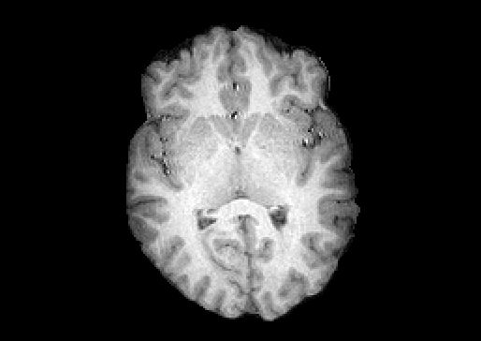
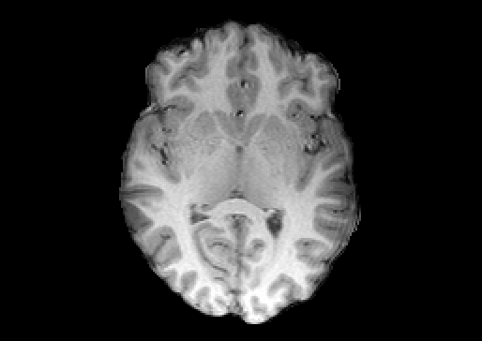
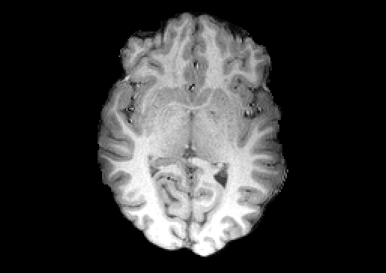
Before
After
CP Head Coil Phased Array Phased Array
no iPAT GRAPPA iPAT

Slide 41
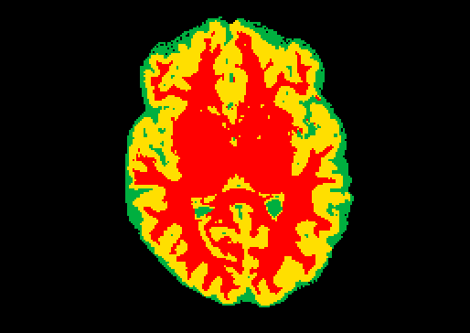
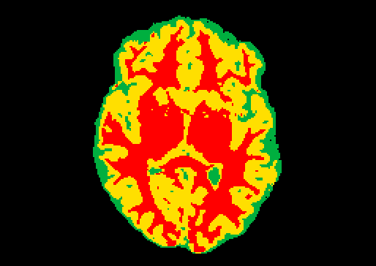
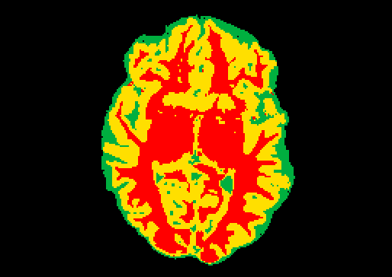
Segmentation Comparison
CP Head Coil Phased Array Phased Array
no iPAT GRAPPA iPAT

Slide 42
Original Images
CP Head Coil Phased Array Phased Array
no iPAT GRAPPA iPAT

Slide 43
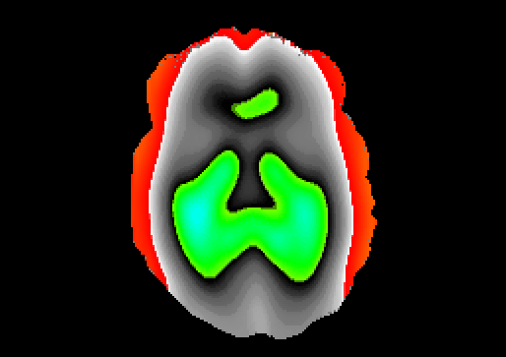
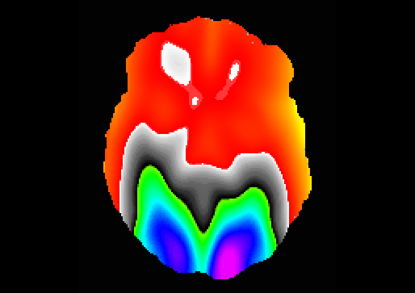
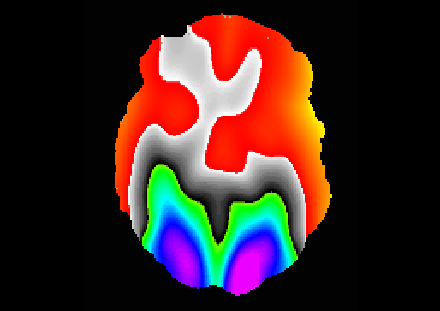
Bias Field Estimate
CP Head Coil Phased Array Phased Array
no iPAT GRAPPA iPAT

Slide 44
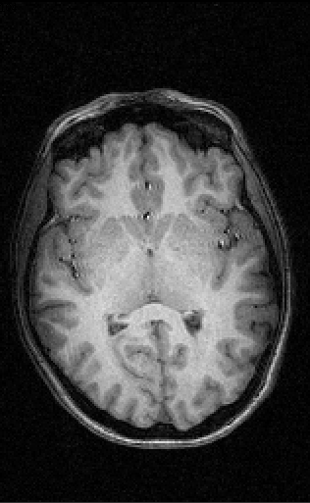
CP Head Coil – Intensity Non-uniformity
Significant fall-off in signal intensity at the left and right extents
Results in left and right edges much darker than rest of brain

Slide 45
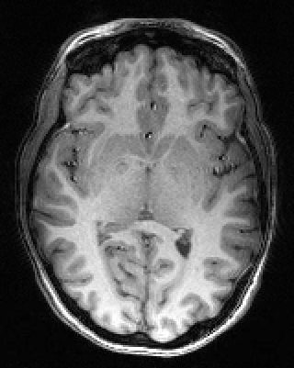
Phased Array Head Coil – Intensity Non-uniformity
Intensities vary by distance from coil elements
Results in significant changes in intensity that vary spatially
Most noticeable in posterior regions such as visual cortex

Slide 46
Correction of Intensity Non-uniformity
SPM and FSL packages have algorithms for correcting intensity non-uniformities
SPM algorithm unsuccessful on both CP and PA head coil data
FAST algorithm from FSL works well on both CP and PA head coil data!

Slide 47
Modulation
Modulation: multiplying the spatially normalised gray matter (or other tissue class) by its relative volume before and after spatial transformation
Non-modulated: – Relative concentration/ density: the proportion of GM (or WM) relative to other tissue types within a region – Hard to interpret
Modulated:
Absolute volumes
Computer Expert

